Slide 1
Electrical Circuits
EEE-281 Lecture Notes
Dr. Özçel Cangül
Lecture Notes by: Dr. Ali Muhtaroğlu
Fall 2023
METU Northern Cyprus Campus
References:
Electric Circuits 10th Ed. by Nilsson & Riedel
Electrical Circuit Analysis 3rd Ed. by Johnson, Johnson, Hilburn, and Scott
Engineering Circuit Analysis 7th Ed. by Hayt, Kemmerly, and Durbin
Fundamentals of Electric Circuits 3rd Ed. by Alexander, and Sadiku

Slide 2
First Order Circuits
Weeks 13-14
Reading: Nilsson & Riedel Chapter 7
Ali Muhtaroğlu

Slide 3
Introduction
When we add resistive circuits to a single storage element, the resulting circuit is called a first-order circuit, because the circuit is characterized by a first-order differential equation.
Will next study:
  Circuits without independent sources : Natural response due to initial energy stored
  Circuits with DC sources : Two additive responses apply –natural response, and forced response due to the independent sources
  Circuits with non-DC sources: Responses to step and pulse sources.

Slide 4
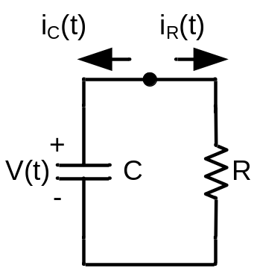
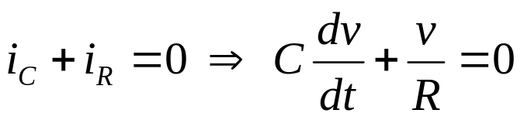
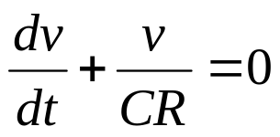
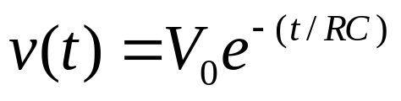
Natural Response of a Simple RC Circuit
(without sources)
Assumption: The capacitor is already charged (by whatever
means) to voltage V₀ at the initial time, or t=0.
Need to determine v(t) for t>0:
KCL at the top node:
which results in the first-order differential equation:
Solving:

Slide 5
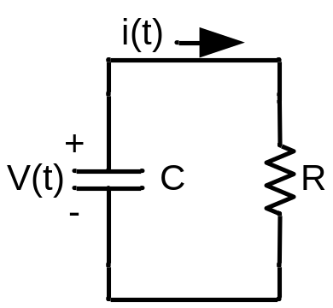
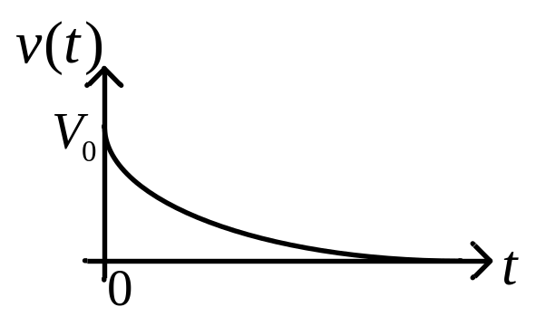
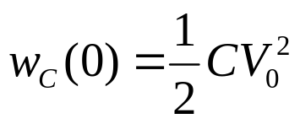
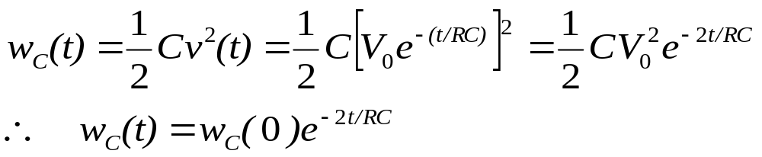

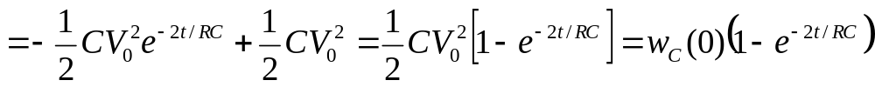

Natural Response of a Simple RC Circuit
(without sources)
: Natural response of the circuit
This is also the transient response.
The response of the circuit after “a long time”
is called the steady-state response, as covered
earlier.
Conservation of Energy:
The energy at initial time (t=0) stored in the capacitor:
At any time t :
As t , the stored energy in the capacitor decays to 0. Through
conservation of energy, the lost energy has to go somewhere in the system:

Slide 6
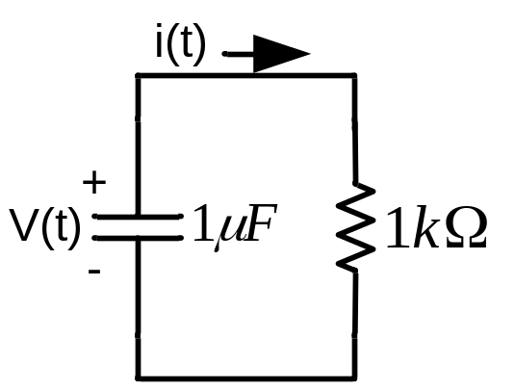
Example
v(0) = 5 V
Find i) i(t)
ii) max power dissipated by the resistor

Slide 7

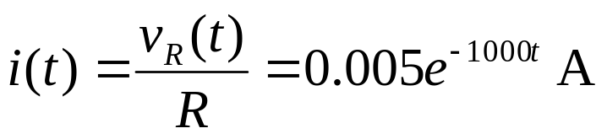
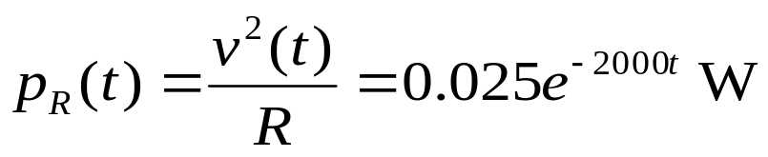
Example
v(0) = 5 V
Find i) i(t)
ii) max power dissipated by the resistor
Answer:
Using KVL, this is also the voltage across the resistor
Therefore, the maximum power dissipated is 25mW at the time
when capacitor starts discharging (t=0).

Slide 8

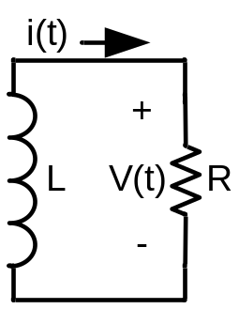
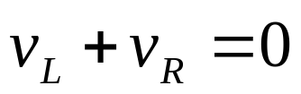
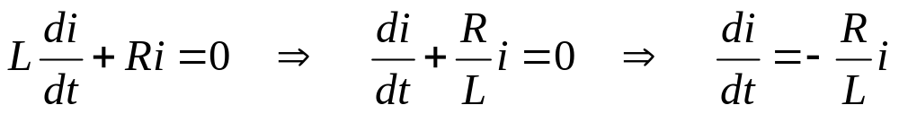
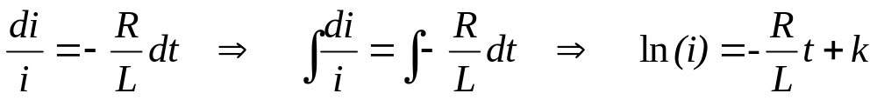
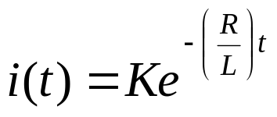
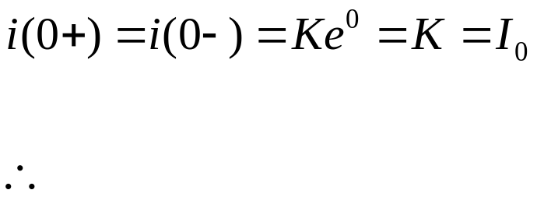
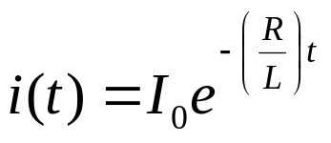
Natural Response of a Simple RL Circuit
(without sources)
Assumption: The inductor is already “magnetized” (by whatever means) to current at the initial time, or t=0.
Need to determine i(t) for t>0:
KVL :
Take the exponential of both sides:
But, using the principle of discontinuity:

Slide 9

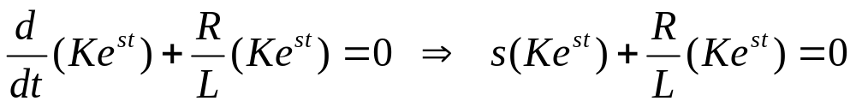

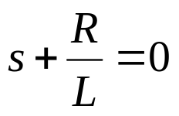
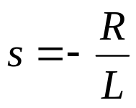
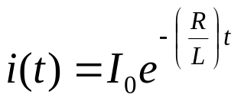
Natural Response of a Simple RL Circuit
(without sources)
There is an alternate way to solve this using characteristic equations.
1) Assume a trial solution:
2) Substitute into the original first-order differential equation:
But cannot be zero because .
Therefore, it must be that if this equation is to hold.
is the characteristic equation for the differential equation.
Solving, .
Therefore,
Using the initial condition as in the previous page:

Slide 10
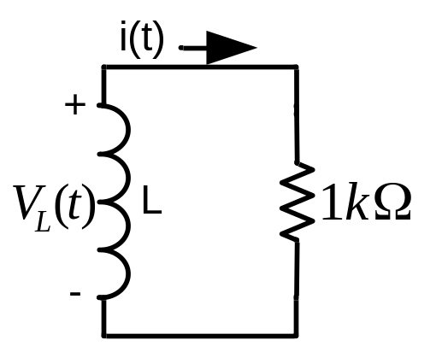

Example
Find i) L
ii) Initial current i(0)

Slide 11
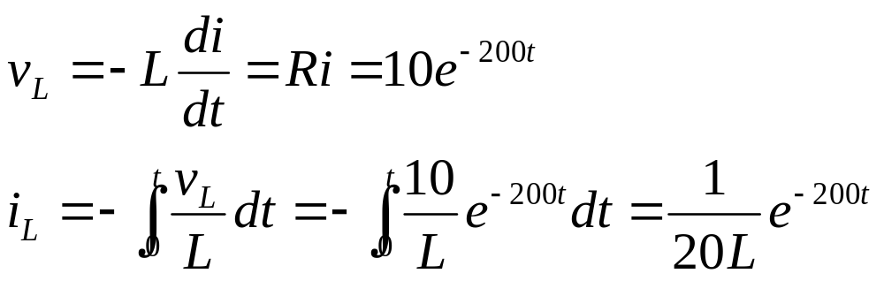
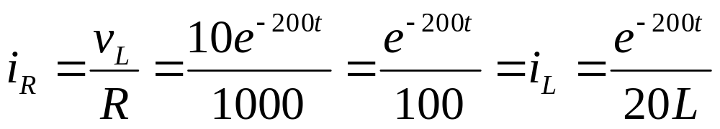
Example
Find i) L
ii) Initial current i(0)
Answer:
Therefore, L=5 H, and i(0)=1/100=10mA

Slide 12
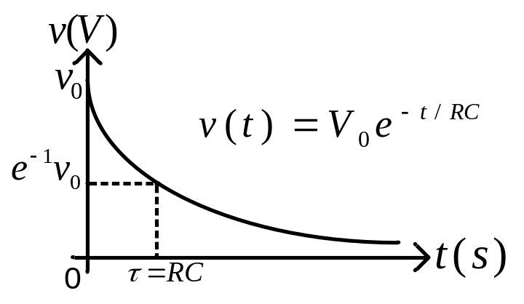
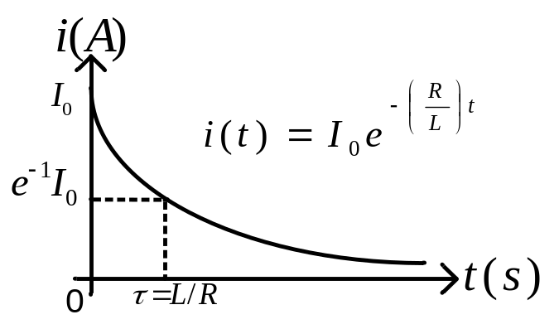
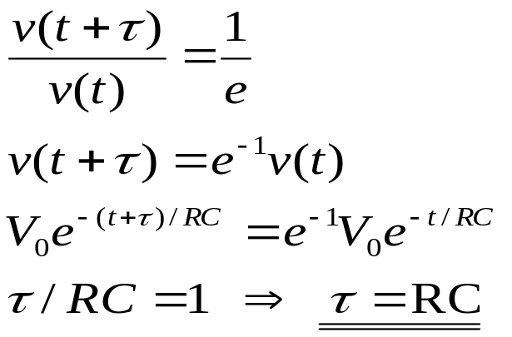
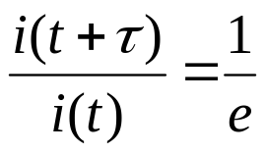
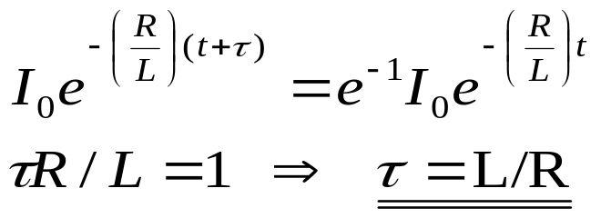
Time Constants
The time constant, τ, characterizes the rate of decay for the natural response. It is defined as the time required for a natural response to decay by a factor of 1/e (0.37). All currents and voltages (responses) of the first order circuits decay with the same time constant, τ.
By definition:
By definition:

Slide 13
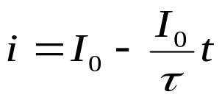
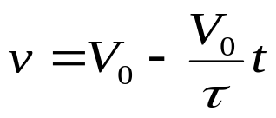
Time Constants
The time constant, τ, characterizes the rate of decay for the natural response. It is defined as the time required for a natural response to decay by a factor of 1/e (0.37). All currents and voltages (responses) of the first order circuits decay with the same time constant, τ.
By definition:
By definition:

Slide 14
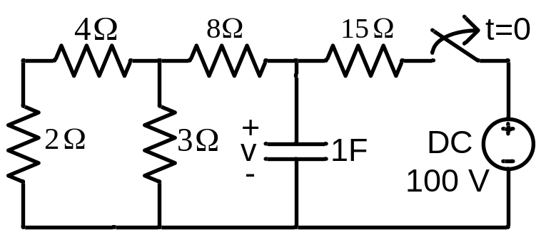
Example
Calculate time constant, τ for this circuit.
Use it to find voltage v for t>0.

Slide 15
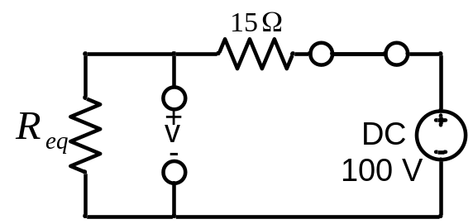
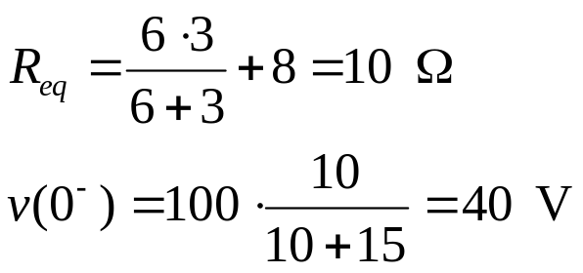

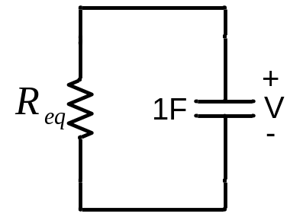
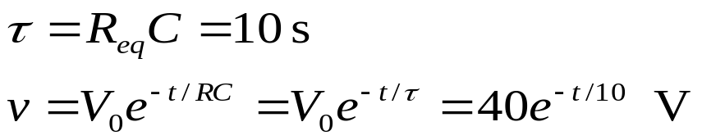
Example
Calculate time constant, τ for this circuit.
Use it to find voltage v for t>0.
Answer:
Steady-state model before t=0:
Due to continuity principle:
Simple RC model for t>0:

Slide 16
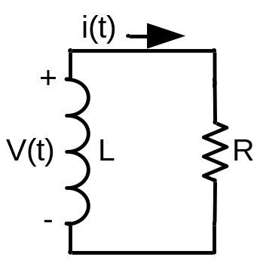
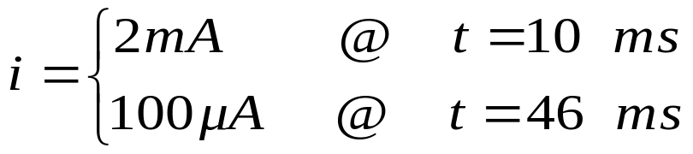

Example:Simple RL Circuit

Slide 17
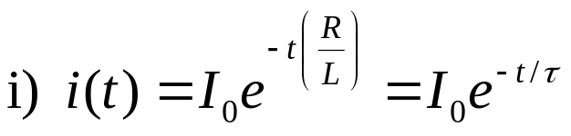
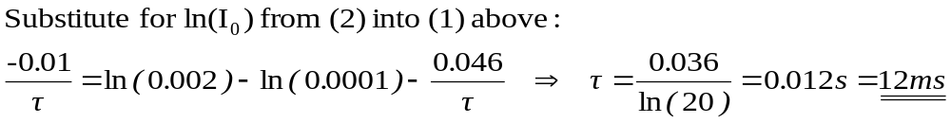
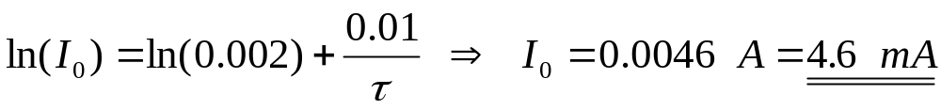
Example:Simple RL Circuit
Answer:
ii) Using (1):

Slide 18
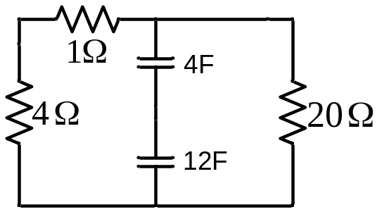
General First Order Circuits
without Sources
We can apply the previous techniques to circuits that can be
reduced to simple RL or RC.
Example: Find the time constant of the below circuit:

Slide 19
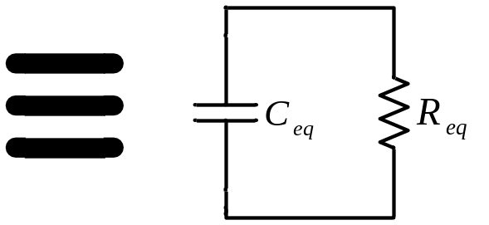
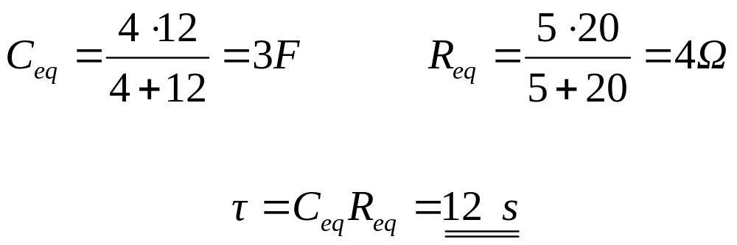
General First Order Circuits
without Sources
We can apply the previous techniques to circuits that can be
reduced to simple RL or RC.
Example: Find the time constant of the below circuit:

Slide 20
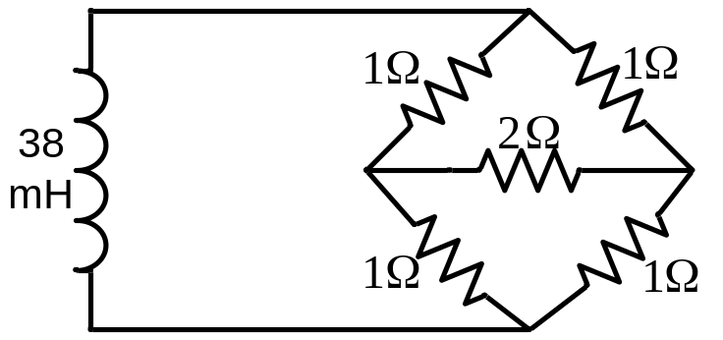
Example
Find the time constant of the following circuit:
2 Ω

Slide 21
Example
Find the time constant of the following circuit:
Answer:
First find the equivalent resistance connected to the terminals of the inductor. Since the resistors are neither in parallel nor in series, cannot directly calculate R_{eq}. Instead, can find the ratio between a test voltage and test current.
2 Ω

Slide 22
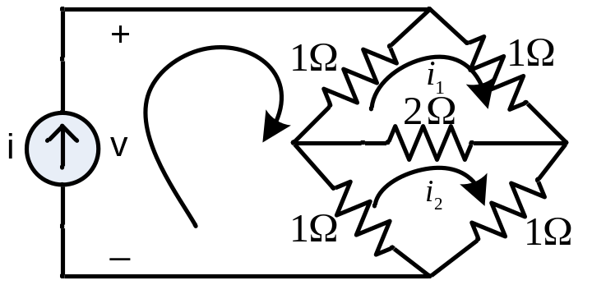
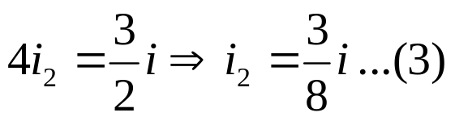
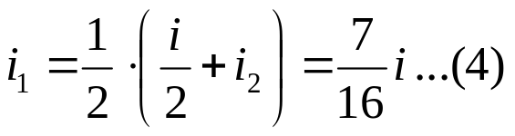

Example
Find the time constant of the following circuit:
Answer:
i
KVL (Mesh 1):
2 Ω
KVL (Mesh 2):
Add (1) and (2):
Substitute for i₂ into (1):
KVL (Around Left Loop):

Slide 23

Example
Find the time constant of the following circuit:
Answer:
i
KVL (Mesh 1):
2 Ω
KVL (Mesh 2):
Add (1) and (2):
Substitute for i₂ into (1):
KVL (Around Left Loop):

Slide 24


Circuits with DC Sources
Circuits driven by constant (dc) independent current or voltage sources in
addition to having initial stored energies.
For t > 0, KCL at top node:

Slide 25
Circuits with DC Sources
Circuits driven by constant (dc) independent current or voltage sources in
addition to having initial stored energies.
For t > 0, KCL at top node:
Forcing term independent of
the unknown time functions

Slide 26


Circuits with DC Sources
Circuits driven by constant (dc) independent current or voltage sources in
addition to having initial stored energies.
For t > 0, KCL at top node:
Forcing term independent of
the unknown time functions
Need a trial v where a linear combination of v and its derivative is constant for
all t>0. Try trial forced solution :

Slide 27




Circuits with DC Sources
Circuits driven by constant (dc) independent current or voltage sources in
addition to having initial stored energies.
For t > 0, KCL at top node:
Forcing term independent of
the unknown time functions
Need a trial v where a linear combination of v and its derivative is constant for
all t>0. Try trial forced solution :
A valid differential equation must also satisfy:
Let denote any solution to the unforced differential equation:
But we know from before:

Slide 28


Circuits with DC Sources
Circuits driven by constant (dc) independent current or voltage sources in
addition to having initial stored energies.
For t > 0, KCL at top node:
Since both forced differential eqn and initial condition needs to be satisfied:
Evaluating at t=0, the initial condition is matched if:
Substitute back into v(t) eqn (1):
Note at t=0, as needed.

Slide 29
Circuits with DC Sources
Summary of the method to solve the forced first order differential equation with constant forcing term and initial conditions:
Find the forced solution by using a trial forced solution = A
2. Find the natural solution by using a trial natural solution = and
solving the characteristic equation for s.
The total solution is the sum (superposition) of natural and forced
solutions. Evaluate at the initial time to find K.

Slide 30

Superposition Example 2
Find i_{L}, the current through the inductor, and i_{c}, the current through the capacitor, as shown, after all the sources have been turned on for a long time.

Slide 31
Superposition Example 2
Find i_{L}, the current through the inductor, and i_{c}, the current through the capacitor, as shown, after all the sources have been turned on for a long time.
Solution:
Since the analysis is done after all the sources have been turned on for a long time, there is no energy initially stored in inductors and capacitors. The component of i_{L} and i_{c} coming from each source has to be calculated independently under steady-state conditions based on the basic principle of superposition (no need to include the response to initial conditions to the superposition).

Slide 32



Superposition Example 2
Find i_{L}, the current through the inductor, and i_{c}, the current through the capacitor, as shown, after all the sources have been turned on for a long time.
Solution:
Since the analysis is done after all the sources have been turned on for a long time, there is no energy initially stored in inductors and capacitors. The component of i_{L} and i_{c} coming from each source has to be calculated independently under steady-state conditions based on the basic principle of superposition (no need to include the response to initial conditions to the superposition).
1. Turn on 100 V source only:

Slide 33



Superposition Example 2
Find i_{L}, the current through the inductor, and i_{c}, the current through the capacitor, as shown, after all the sources have been turned on for a long time.
Solution:
Since the analysis is done after all the sources have been turned on for a long time, there is no energy initially stored in inductors and capacitors. The component of i_{L} and i_{c} coming from each source has to be calculated independently under steady-state conditions based on the basic principle of superposition (no need to include the response to initial conditions to the superposition).
1. Turn on 100 V source only:
2. Turn on 50 V source only:

Slide 34



Superposition Example 2
Find i_{L}, the current through the inductor, and i_{c}, the current through the capacitor, as shown, after all the sources have been turned on for a long time.
Solution:
Since the analysis is done after all the sources have been turned on for a long time, there is no energy initially stored in inductors and capacitors. The component of i_{L} and i_{c} coming from each source has to be calculated independently under steady-state conditions based on the basic principle of superposition (no need to include the response to initial conditions to the superposition).
1. Turn on 100 V source only:
2. Turn on 50 V source only:
3. Turn on 10 A source only:

Slide 35



Superposition Example 2 (continued)
Find i_{L}, the current through the inductor, and i_{c}, the current through the capacitor, as shown, after all the sources have been turned on for a long time.
Solution:
Since the analysis is done after all the sources have been turned on for a long time, there is no energy initially stored in inductors and capacitors. The component of i_{L} and i_{c} coming from each source has to be calculated independently under steady-state conditions based on the basic principle of superposition (no need to include the response to initial conditions to the superposition).
4. Turn on the sinusoidal voltage source only:
since there is no energy originally stored in the inductor, and all of the current from the sinusoidal source goes through the short-circuit across the resistors and the inductor.

Slide 36


Superposition Example 2 (continued)
Find i_{L}, the current through the inductor, and i_{c}, the current through the capacitor, as shown, after all the sources have been turned on for a long time.
Solution:
Since the analysis is done after all the sources have been turned on for a long time, there is no energy initially stored in inductors and capacitors. The component of i_{L} and i_{c} coming from each source has to be calculated independently under steady-state conditions based on the basic principle of superposition (no need to include the response to initial conditions to the superposition).
4. Turn on the sinusoidal voltage source only:
since there is no energy originally stored in the inductor, and all of the current from the sinusoidal source goes through the short-circuit across the resistors and the inductor.
5. Summing up components:

Slide 37


Unit Step Function

Slide 38


Unit Step Function
Voltage step source:
Current step source:

Slide 39


Unit Step Function
Voltage step source:
Current step source:
The shifted unit step:

Slide 40
Unit Step Function

Slide 41






Unit Step Function
+
=

Slide 42


Unit Step Function

Slide 43

Unit Step Function

Slide 44

Unit Step Function
This is a pulse function.

